Slide 3
Thank you for attending our Bid Big Auction!
Our Presenting Sponsor….

Slide 4
Thank you for attending our Bid Big Auction!
We’d also like to thank our Contributing Sponsor…

Slide 6
We Are the World Lyrics
There comes a time
When we heed a certain call
When the world must come together as one.
There are people dying,
Oh, and it’s time to lend a hand
To life, the greatest gift of all.

Slide 7
We Are the World Lyrics
We are the world,
We are the children.
We are the ones who make a brighter day,
so let’s start giving.
There’s a choice we’re making,
We’re saving our own lives.
It’s true we’ll make a better day,
just you and me.

Slide 10
Thank you for attending our Bid Big Auction!
Our Presenting Sponsor….

Slide 11
Thank you for attending our Bid Big Auction!
We’d also like to thank our Contributing Sponsor…

Slide 13
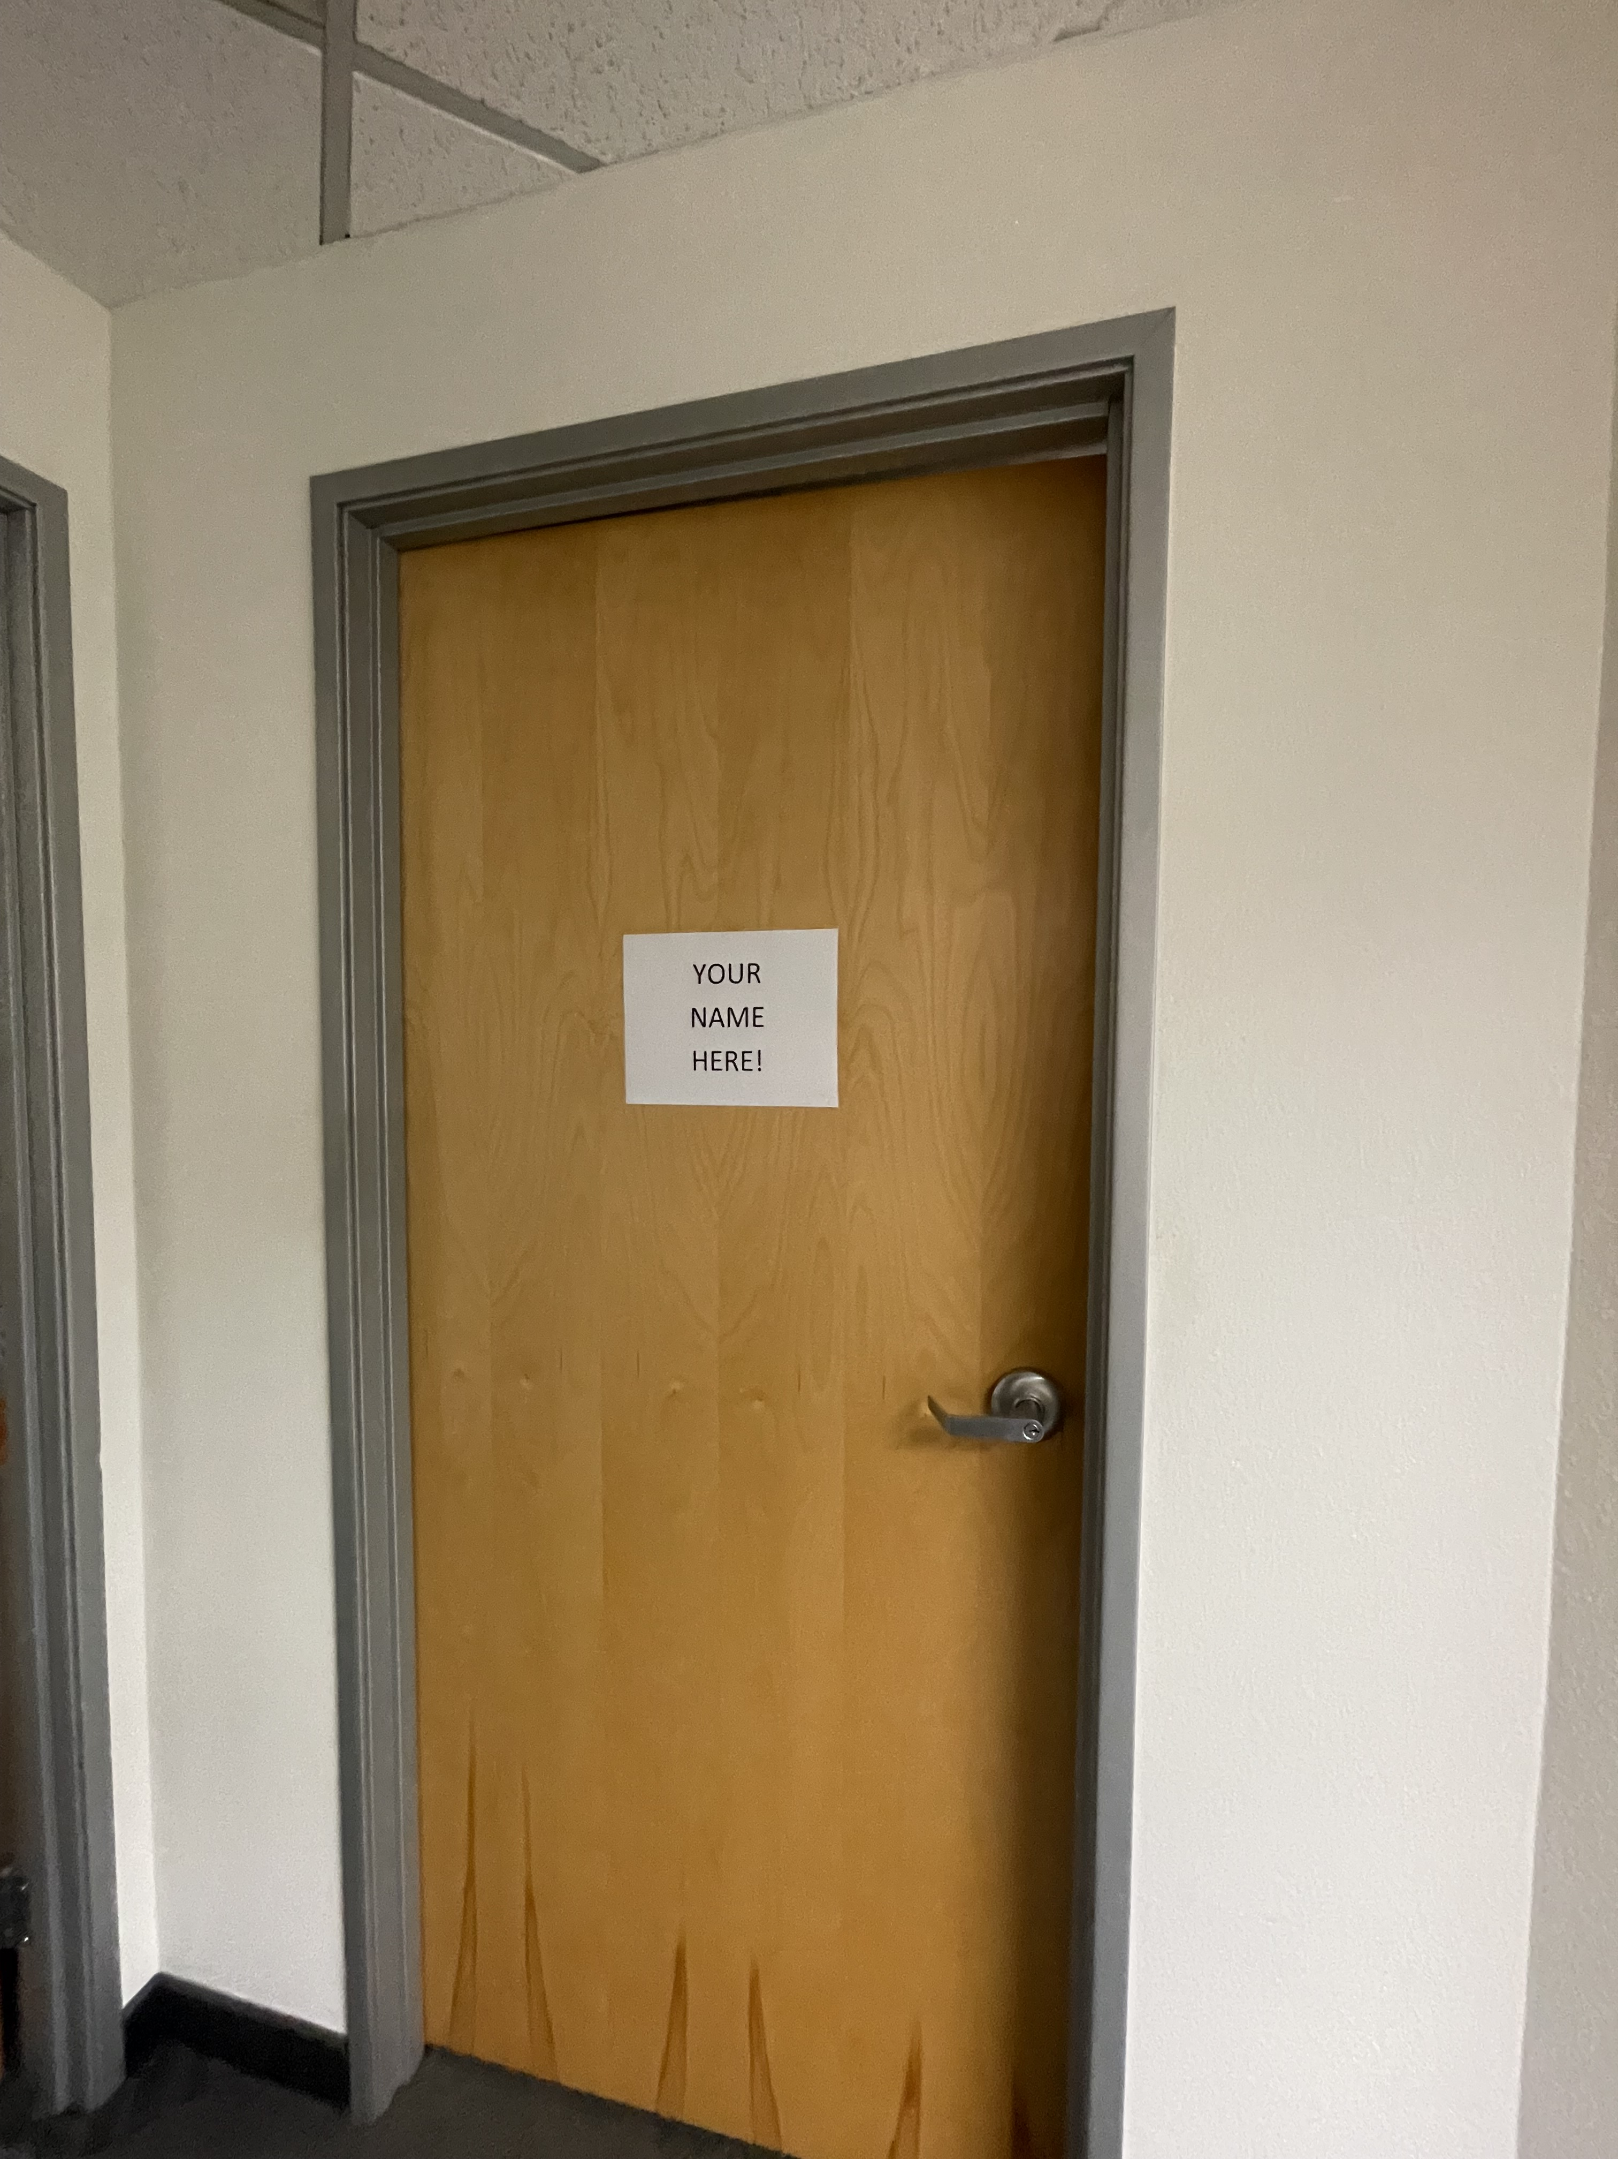
SURPRISE ITEM!
Naming Rights to the Executive Director Suite

Slide 15
Live Auction Item #1:
4 Comic-Con Passes for 2023

Slide 17
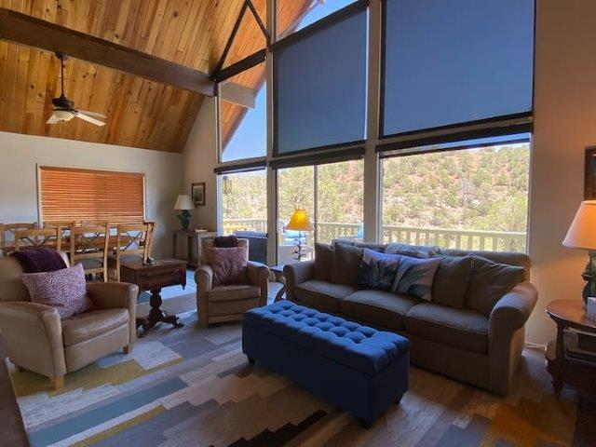
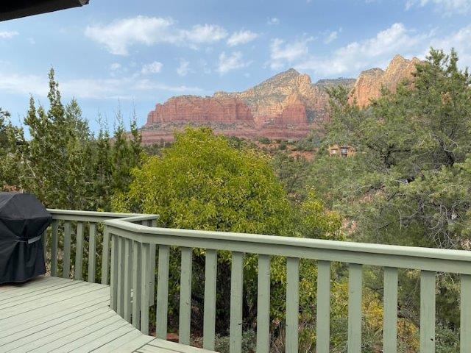
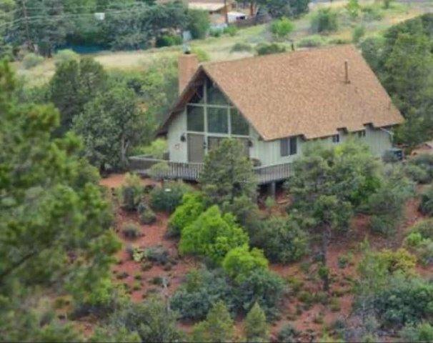
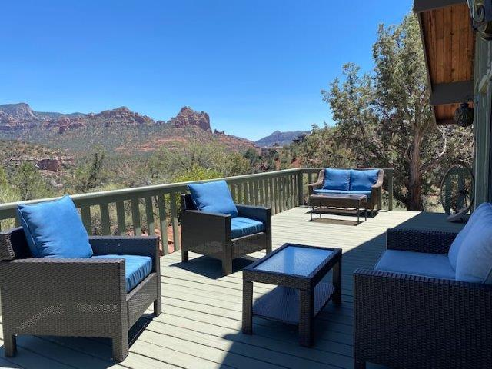
Live Auction Item #2:
One Week Stay in Sedona

Slide 19
Live Auction Item #3:
Sunset Cruise on the 50 Ft Vacanza

Slide 21
Live Auction Item #4:
One Week Stay at Cliffs of Princeville Resort in Kauai

Slide 23
Live Auction Item #5:
Dinner for 8 with President Judy,
First Dude Mike and First Dog Harley

Slide 26
Committee Meetings
205A - DEI

